Slide 1



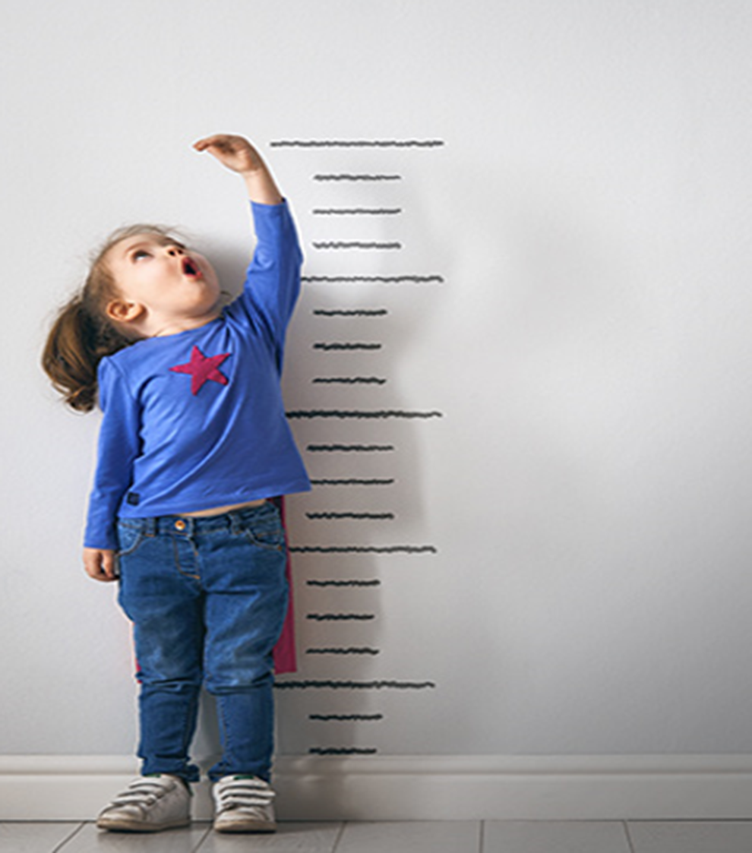


FTTell
Diagnosis failure to thrive among children
Capstone Project Phase B -24-1-D-3
Sabeel Hamood
Ehsan Sarboukh
Supervisor:
Dr. Natali Levi-Soskin

Slide 2

What is Failure To Thrive?
FTT (Failure to Thrive) is a medical term used to describe inadequate weight gain or inadequate weight loss in children or infants, indicating inadequate growth and development.
FTT can be diagnose among all different ages of children.

Slide 3
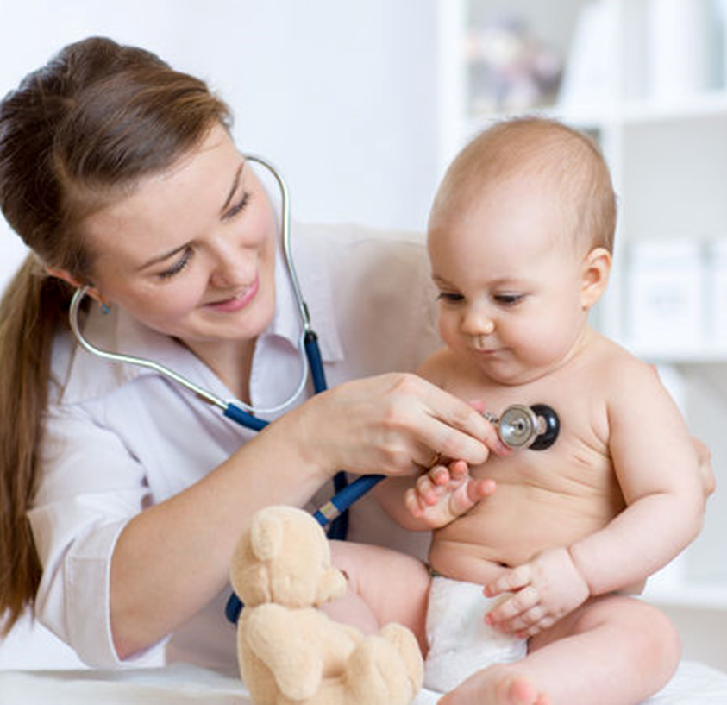


The Problem
The FTT diagnosis process is lengthy and may lead to various medical complications for the patient due to delayed identification and treatment.
Despite standardized quantitative definitions, FTT can be overlooked or misdiagnosed.
Non-organic FTT is often diagnosed without quantitative data, as pediatricians must observe the child's behavior, which makes the task impossible.

Slide 4
Existing Solutions
Most used methods
Growth Monitoring.
Medical History and Physical Examination.
Nutritional Assessment.
Psychosocial Evaluation.
Rourke Baby Record (RBR)
Developed in Canada is a comprehensive tool for growth monitoring but is not used for diagnosing FTT.

Slide 5


System Requirements

Slide 6
Functional Requirements
The system allows the users to insert new data.
The system stores data in a database.
The system shows the analysis of the result in real time.
The system offers pediatricians registration for the system.
The system can be used from any location with Wi-Fi access.
The system allows pediatricians the usage of the camera for diagnosing (Computer Vision).
The systems offers a guidance tutorial.
The system gives permission to authorized users to login (Pediatrics).
The system offers to pediatricians a suitable nutrition plan for each patient.

Slide 7
Non-Functional Requirements
user friendly interface.
Simple interaction mechanism.
Real time analysis.
The data is secured really well
Application works 24/7

Slide 8
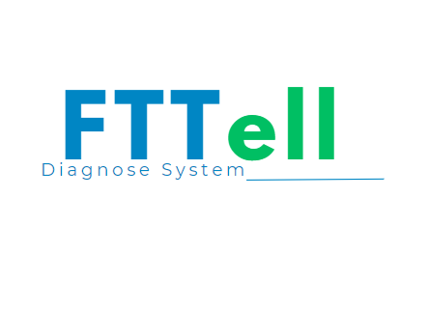
Our Solution

Slide 9
FTTell
FTTell is a modern diagnostic system for children suffering from Failure to Thrive (FTT), combining user-friendly growth assessment tools with advanced pediatrician features. It uses validated formulas, computer vision, and AI-generated nutritional plans for early detection and professional evaluation.

Slide 10



Frontend Technologies

Slide 11


Backend Technologies
Express js

Slide 12

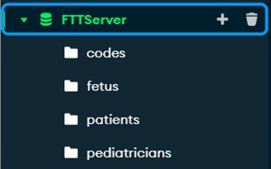

Database

Slide 13

AI-Tool ChatGPT
const chatPromptBreakfast =`The result is: ${resultText}. Write me a nutrition plan for breakfast for this child considering the allergic and the symptoms with bullet points-without including any introductory or repetitive statements, add in the plan food that suitable to the child age and allergies.`;
const chatPromptLunch = `The result is: ${resultText}. Write me a nutrition plan for lunch for this child considering the allergic and the symptoms with bullet points-without including any introductory or repetitive statements, add in the plan food that suitable to the child age and allergies.`;
const chatPromptDinner = `The result is: ${resultText}. Write me a nutrition plan for dinner for this child considering the allergic and the symptoms with bullet points-without including any introductory or repetitive statements, add in the plan food that suitable to the child age and allergies.`;

Slide 14


Computer Vision
FER

Slide 15
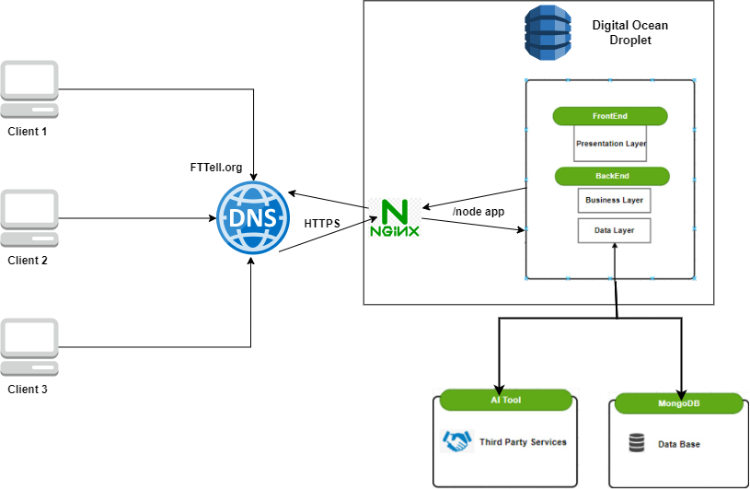
3-Tier Architecture

Slide 16
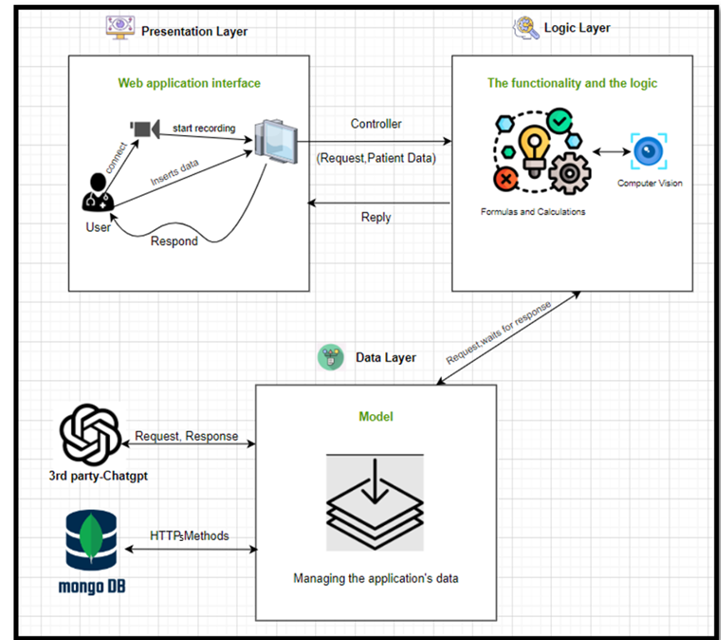
MVC - Architecture

Slide 17
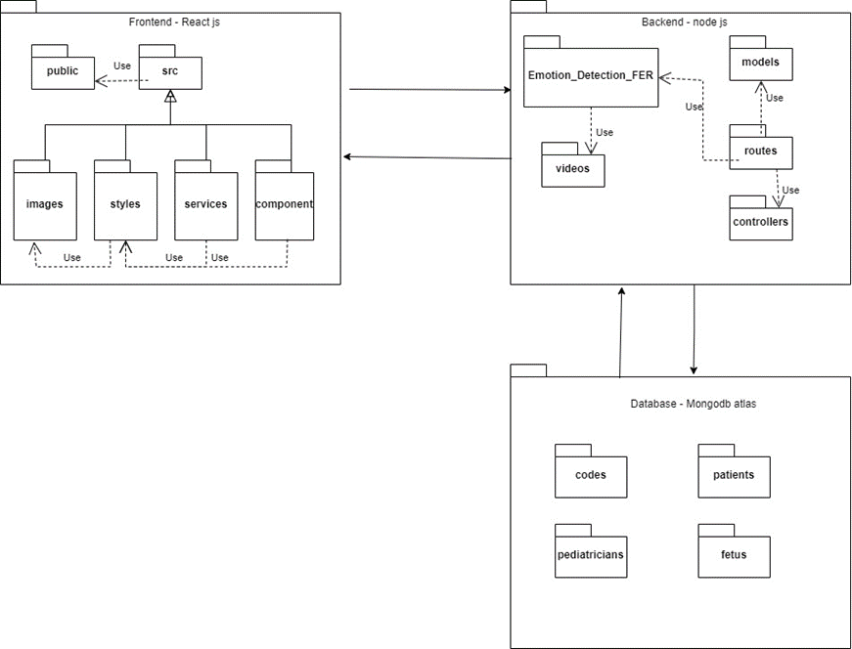
Package Diagram

Slide 18
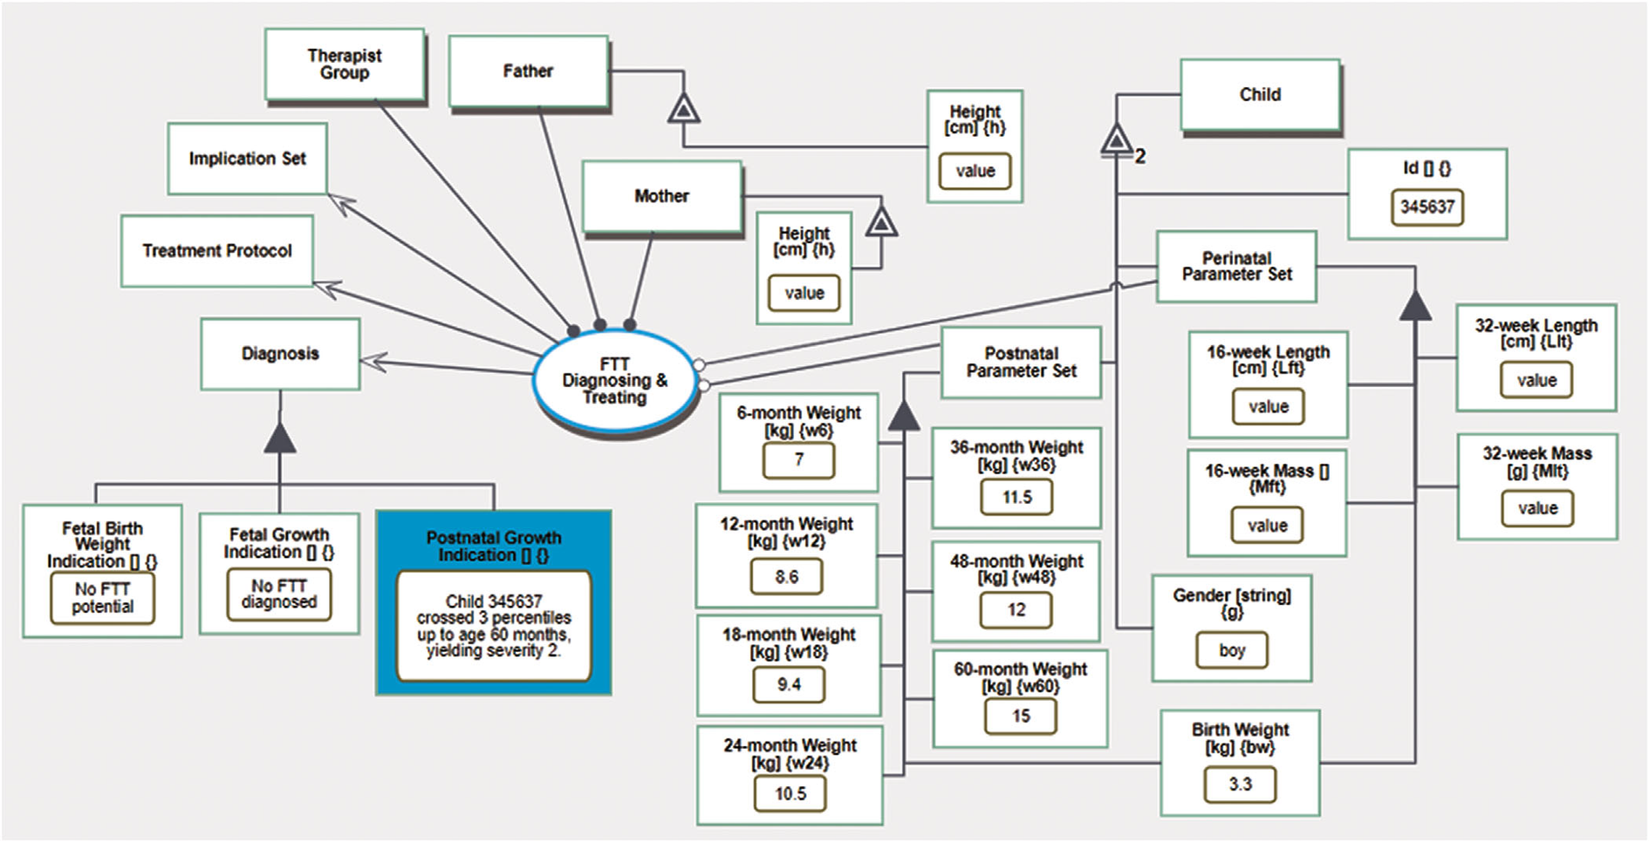
OPM
Levi‐Soskin, N., Yasin, F., Dori, D., & Shaoul, R. (2023). Model‐based diagnosis with FTTell: Diagnosing early pediatric failure to thrive. Systems Engineering.

Slide 19




Challenges and Constraints
Restrict access
securing sensitive data
Using computer vision

Slide 20
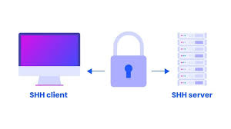

Challenges and Constraints
Secure Client-Server Communication
Accuracy in AI result
Deployment

Slide 21

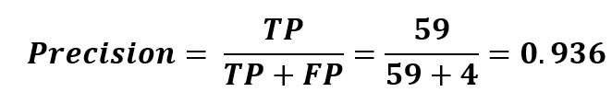
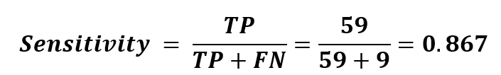
Performance Metrics

Slide 22
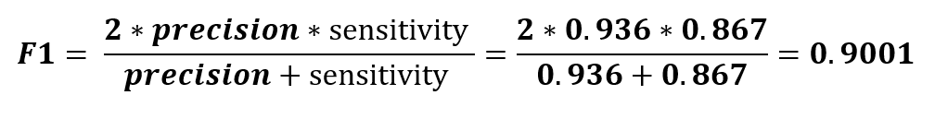
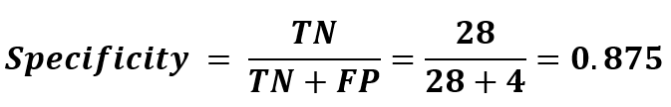
Performance Metrics
F 1 score – the harmonic mean (average) of the precision and sensitivity
Specificity- the ratio between the number of infants that were correctly labeled by
FTTell as not having FTT and all the infants that actually did not have FTT.

Slide 23
Testing Procedure
User Experimentation and Testing Methodology.
Testing Formulas and Diagnostic Accuracy for Non-Pediatrician Users.
Testing the diagnosis process for pediatrician.
Networking and API testing with Postman.

Slide 24
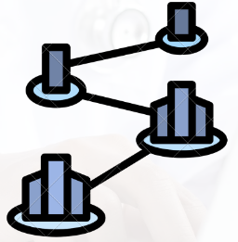



Project Success Metrics
User Friendly
Estimated Accuracy
90% +
Early diagnoses
Scalability

Slide 25
Simulation
Tutorial link on YouTube:
https://www.youtube.com/watch?v=rVsznUSO1JY
Link to the web application:
https://www.fttell.org/

Slide 26
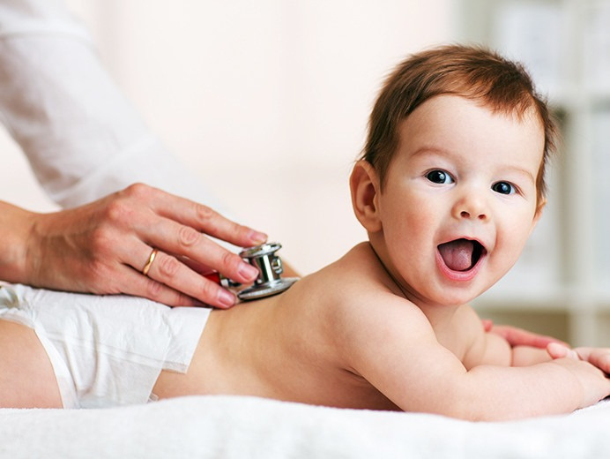
Thank
You.
For Your Attention

